Slide 1

Artificial intelligence (AI101B) Even Semester Session 2024-25
Anik kushwaha, (202410116100026)
Ankit Kumar, (202410116100027)
Bishop Tyagi (202410116100050)
Bobby Karnik, (202410116100051)
Project Supervisor:
Mr. Apoorv Jain
ASST. PROFESSOR

Slide 2

Weather Data Analysis
• Weather forecasting plays a crucial role in agriculture, transportation, and disaster management.
• AI techniques help in identifying trends and making better predictions.
• This project analyzes weather data using Python and visualization techniques.

Slide 3
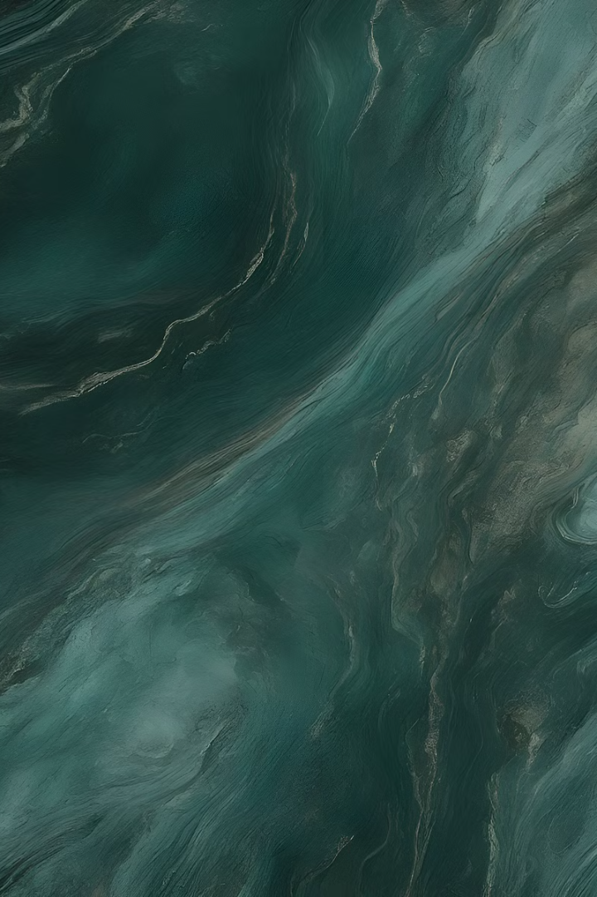
Data Collection Methods
Libraries
Data Acquisition
matplotlib
Acquire real-time and historical data. Focus on temperature, humidity, and wind speed. Proper methods ensure comprehensive datasets.
seaborn
pandas
Use Requests and PyOWM for efficient data retrieval. Key parameters include temperature and humidity.

Slide 4




Data Preprocessing
Data Collection
Weather dataset stored in CSV format..
Data Cleaning
Employ data cleaning techniques. Prepare datasets thoroughly.
Data Conversion
Convert timestamp and location data. Ensure data readiness for analysis.

Slide 5

Exploratory Data Analysis
Descriptive Statistics
Correlation Matrix
Distribution Plots
Use NumPy for descriptive stats.
Analyze variable correlations.
Use Seaborn for distribution analysis.

Slide 6





Advanced Visualization
Complex Graphics
Time Series Plots
Use Matplotlib for weather graphics.
Plot temperature time series.
1
2
Interactive Maps
4
Heatmaps
3
Create geographical weather mappings.
Visualize weather correlations.

Slide 7
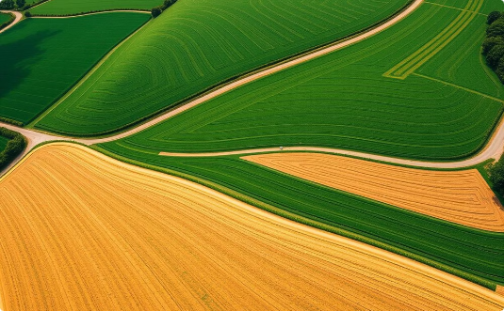
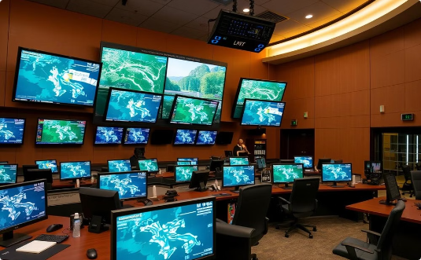
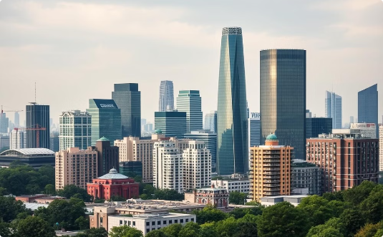
Real-world Applications
Agriculture
Emergency Management
Urban Planning
Crop planning with weather insights.
Risk assessment for disasters.
Infrastructure design informed by data.

Slide 8

Conclusion
Python's Power
Python excels in weather analysis.

